Slide 1

FruitPunch.AI/Code
Epoch 7: Monte Carlo
Methods
24.09.2019
M. Alican Noyan

Slide 2
Question 1

Slide 3
Urn = 70 numbers with 7 unique numbers
Randomly choose 20 numbers from the urn
Find how many distinct numbers (i.e. colors) there are
Repeat
n times
6.6809
4 | 5 | 6 | 7
4 | 252 | 2675 | 7069

Slide 4

Question 2 Estimate 3.14159265359…

Slide 5
https://www.deeplearningbook.org/

Slide 7
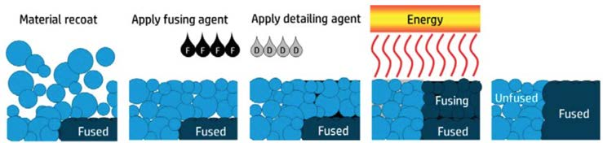
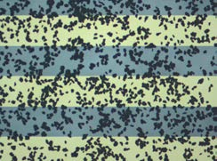
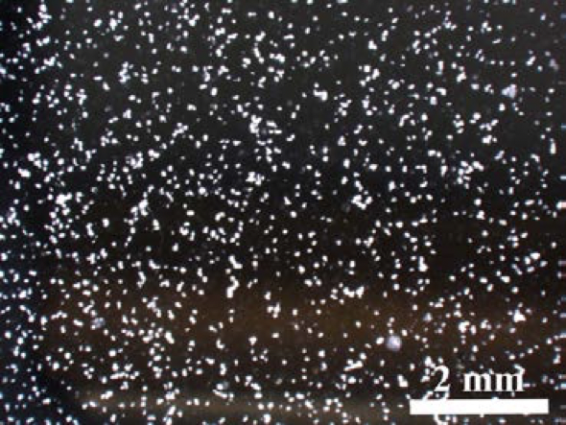
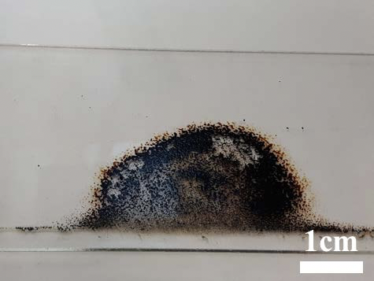
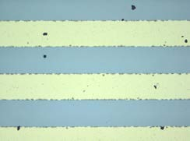
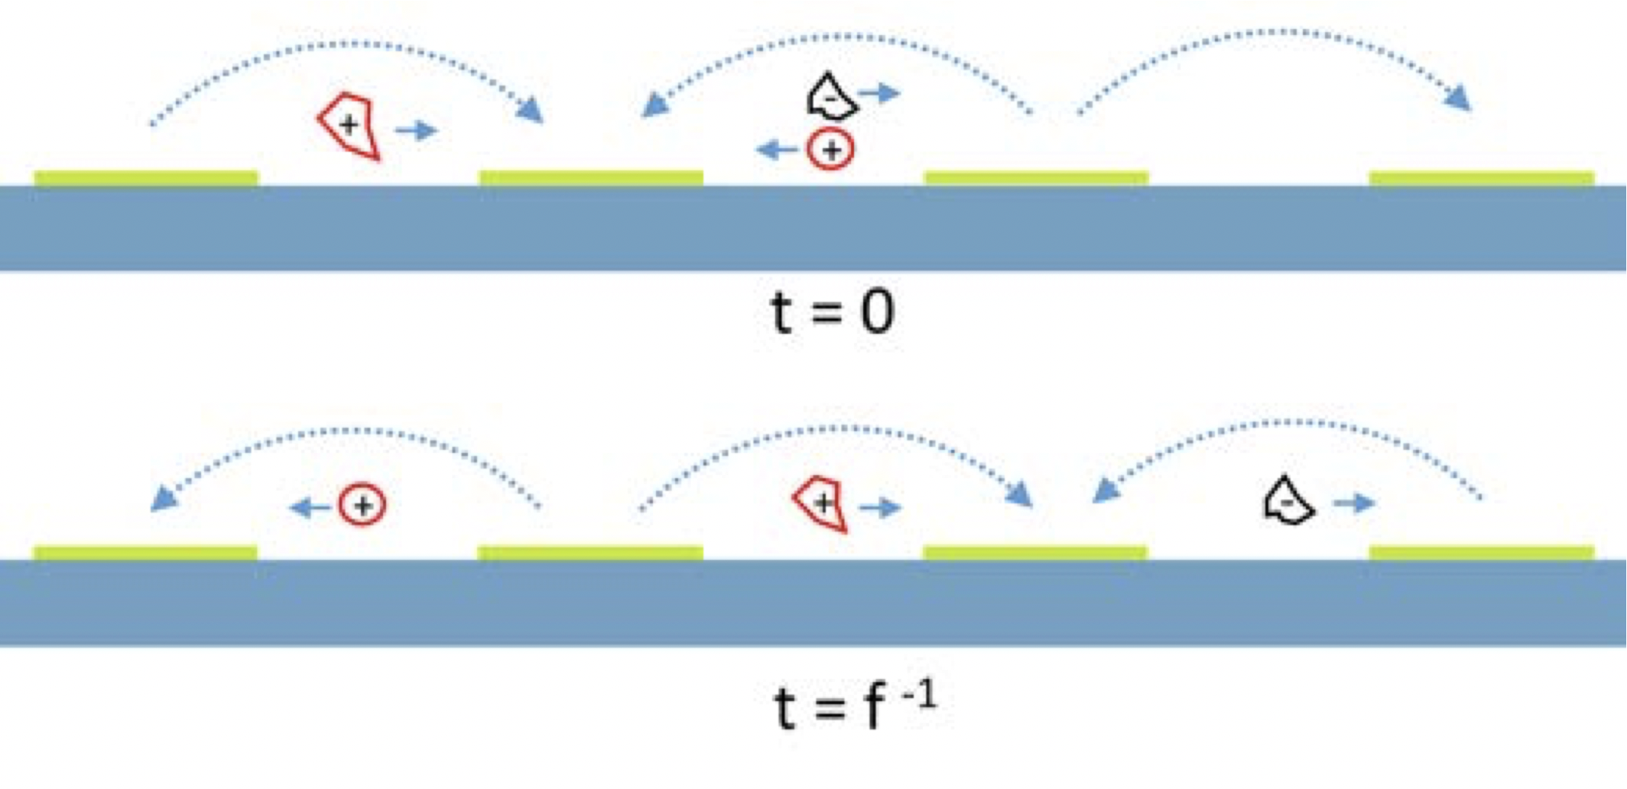
Self-cleaning optical surfaces for the inkjet and 3D printing industry (https://www.tdx.cat/handle/10803/456201)

Slide 8
Question 3
Trench
Gap 0 – 2 nm
Insulator
Electrode
Trench N (100 nm, 2 nm)
Electrode N (95 nm, 1 nm)
Insulator N (4 nm, 0.5 nm)

Slide 9
Question 4 Monty Hall Problem
1
2
3

Slide 10
Question 4 Monty Hall Problem
1
2
3

Slide 11
Question 5

